Slide 1
Three Processions
Sunday AM, April 5, 2020
Rev. Ernie Karjala

Slide 2
No Accident
Newspaper Ad:
Lost--one dog. Brown hair with several bald spots. Right leg broken due to auto accident. Left hip hurt. Right eye missing. Left ear bitten off in a dog fight. Answers to the name "Lucky.“*
*--James S. Hewett, Illustrations Unlimited (Wheaton: Tyndale House Publishers, Inc, 1988) p. 100

Slide 3
Jesus Crucifixion No Accident
Well, maybe that dog really wasn’t so lucky.
However, we should never consider Jesus of Nazareth was unlucky and got crucified sort of by accident.
Some say that Jesus didn’t really intend to get himself killed.
He was just somebody who had only too recently fallen off the turnip truck
He got caught up in the bitter and hostile flow of politics between Imperial Rome and Occupied Israel.

Slide 4
Jesus Crucifixion Was the Will of the Father
Jesus didn’t just carelessly stumble into the events that led to His crucifixion.
Absolutely not: Jesus and His Father had to motivate people to crucify Him on time.
Peter tells Jews from all over the Roman World on the Day of Pentecost that they had crucified the Messiah.
^{NIV} Acts 2:23 This man was handed over to you by God's set purpose and foreknowledge; and you, with the help of wicked men, put him to death by nailing him to the cross.

Slide 5
Jesus Crucifixion Was the Will of the Father
And so did the early Church in Jerusalem in a prayer recorded in the Book of Acts:
^{NIV} Acts 4:27 Indeed Herod and Pontius Pilate met together with the Gentiles and the people of Israel in this city to conspire against your holy servant Jesus, whom you anointed. 28 They did what your power and will had decided beforehand should happen.
Jesus had to die where He died, when He died, how He died, and why He died or we wouldn’t be saved!

Slide 6
Jesus’ First Two Steps to Ensure Crucifixion
Jesus has already taken two steps to ensure that He would be crucified on time.
First, He had raised Lazarus from the dead
^{NIV} John 11:46 [Some of the Jews who witnessed the resurrection of Lazarus] went to the Pharisees and told them what Jesus had done. 47 Then the chief priests and the Pharisees called a meeting of the Sanhedrin. "What are we accomplishing?" they asked. "Here is this man performing many miraculous signs. 48 If we let him go on like this, everyone will believe in him, and then the Romans will come and take away both our place and our nation."

Slide 7
Jesus’ First Two Steps to Ensure Crucifixion
^{NIV} John 11:49 Then one of them, named Caiaphas, who was high priest that year, spoke up, "You know nothing at all! 50 You do not realize that it is better for you that one man die for the people than that the whole nation perish."
Caiaphas was actually being prophetic!
^{NIV} John 11:51 He did not say this on his own, but as high priest that year he prophesied that Jesus would die for the Jewish nation, 52 and not only for that nation but also for the scattered children of God, to bring them together and make them one. 53 So from that day on they plotted to take his life.

Slide 8
The Reaction of Jewish Leadership
This got the religious authority opposed to Jesus to start working on how to put him to death.
The resurrection of Lazarus was the impetus.
Caiaphas prophecy gave them the spiritual excuse and authority.
In terms of God’s purposes, Caiaphas happened to be right this time!
God can hit a straight lick with a crooked stick and that a broken clock is right twice a day.

Slide 9
The Reaction of Jewish Leadership
They made a plan to kill Lazarus as well. (John 12:10)
Trouble was, the religious authority didn’t want to put Jesus to death during the Passover.
"But not during the Feast," they said, "or the people may riot." (^{NIV}Mark 14: 2)
Be that as it may, to fulfill the type of the Passover Lamb, the Messiah just had to die during Passover.

Slide 10
The Second of Jesus’ First Two Steps
Second, Jesus let the woman anoint His head with nard at a meal in Bethany.
This irritated several people, but especially Judas, who got so worked up about this that he went to the religious authority and conspired to hand Jesus over.
This took control of the timing of Jesus trial and crucifixion out of their hands and put it in Judas’ hands.
And this, in turn, put the timing of His crucifixion into Jesus hands.

Slide 11
The Third Step
The Next step after these first two was what we call the “Triumphal Entry”.
This attracted a crowd of Jews in town for the Passover feast.
^{NIV} John 12:12 The next day the great crowd that had come for the Feast heard that Jesus was on his way to Jerusalem. 13 They took palm branches and went out to meet him, shouting, "Hosanna!" "Blessed is he who comes in the name of the Lord!" "Blessed is the King of Israel!" 14 Jesus found a young donkey and sat on it, as it is written:
What they shouted is called the “Messianic Refrain”.

Slide 12
The Third Step
^{NIV} John 12:15 "Do not be afraid, O Daughter of Zion; see, your king is coming, seated on a donkey's colt." 16 At first his disciples did not understand all this. Only after Jesus was glorified did they realize that these things had been written about him and that they had done these things to him. 17 Now the crowd that was with him when he called Lazarus from the tomb and raised him from the dead continued to spread the word. 18 Many people, because they had heard that he had given this miraculous sign, went out to meet him. 19 So the Pharisees said to one another, "See, this is getting us nowhere. Look how the whole world has gone after him!"

Slide 13
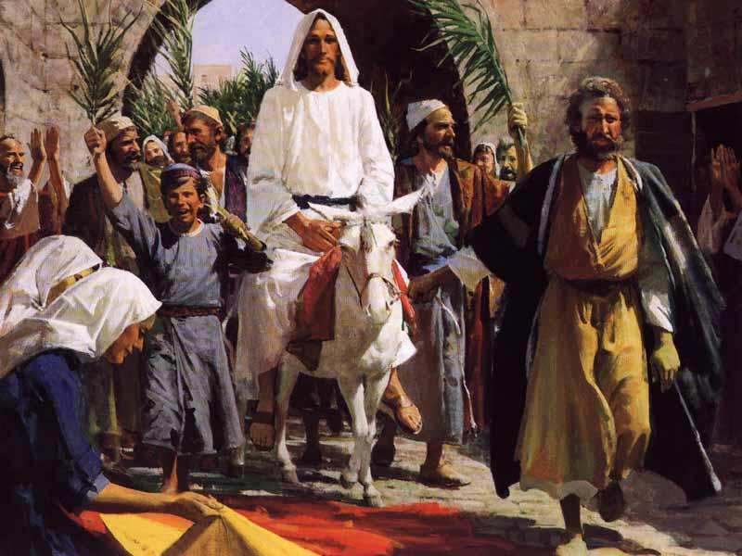

Slide 14
The Donkey Was A Sign
We need to talk about the donkey.
Unlike us Americans, Jewish people in Jesus day didn’t think that riding a donkey ruined their image.
Kings rode donkeys and were proud to do it. Jesus was riding in as a King, and He knew it!
Riding the donkey was a sign of peaceful intention, a lack of animosity.
Had he ridden a horse that would have meant war!
Remember this, though: The next time He enters Jerusalem, it will BE on a horse!

Slide 15
The Donkey Was Also a Miracle
Through a miracle of provision, Jesus “found” a female donkey and her colt.
He rode the colt, and the thing was, the colt had never been ridden.
Riding the donkey colt fulfilled the Messianic prophecy in Zechariah 9:9:
^{NIV} Zechariah 9:9 Rejoice greatly, O Daughter of Zion! Shout, Daughter of Jerusalem! See, your king comes to you, righteous and having salvation, gentle and riding on a donkey, on a colt, the foal of a donkey.

Slide 16
The Procession of the Passover Lamb
There had been an earlier procession that was taking place just before Jesus got there.
The High Priest headed a procession on this day to bring a select lamb, without blemish, to the Temple.
This procession was accompanied by palm fronds and crowds of worshippers shouting “Hosanna”. .
The Passover Lamb of the High Priest was then examined for four days to ensure that it was without defect

Slide 17
Jesus Changed Things
Jesus, being a faithful Jew, joined this procession.
Everybody else walked as was customary and expected, but Jesus rode the donkey colt.
This, of course, really singled Him out!
This became Jesus’ “triumphal entry” shortly thereafter.
People had palm fronds ready from earlier procession.
This was no conspiracy on Jesus’ part to try to fulfill prophecy.

Slide 18
Lazarus Resurrection Drew the Crowd
The crowd gathered around Jesus probably when He joined the High Priest’s parade.
The news about Lazarus made Him an attraction.
There was the Judean crowd of well-wishers and curiosity seekers.
There were the thousands of pilgrims in Jerusalem and surrounding towns there for the Feast of Passover.
Young people were prominent.
They waved palm fronds and spread them and their cloaks on the road before Him
They shouted “Hosanna! Blessed is He that cometh in the Name of the Lord!” … the Messianic Refrain!

Slide 19
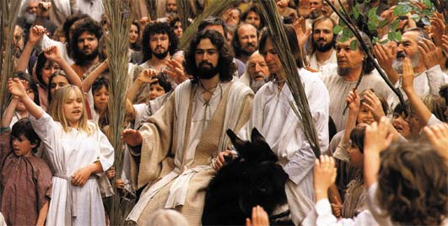
The Press of the Crowd, the Palm Branches

Slide 20
“Hosanna” Was a Very Meaningful Word
A little story:
“On Palm Sunday, when the pastor described Jesus' approach to Jerusalem and how the crowds cried, ‘Hosanna, Hosanna!’ Little Stephanie, sitting on her mother’s lap, perked up and began to sing, ‘Oh, Hosanna, now don't you cry for me!’ -- Brenda Fossum, Duluth, MN. Today's Christian Woman, "Heart to Heart."
Of course, that’s not how you use the word Hosanna!
No, “Hosanna” is not a name and it has real meaning.
The crowd knew it, and they were shouting it intentionally.
It meant, “Save now!” or “Save Us Now!”

Slide 21
“Hosanna” Was a Very Meaningful Word
You see, some 195 years before this date, a priest named Judas Maccabeaus had revolted his Greek leaders.
He was successful in his revolt and entered into Jerusalem in triumph.
He had beat Antiochus Epiphanes and made Judah an independent nation. .
Crowds of Jews waved and strewed palm fronds and shouted the Messianic refrain, just like now.

Slide 22
“Hosanna” Was a Very Meaningful Word
The donkey, palms, and Hosannas were all a cry for Israel’s deliverance and freedom from the Gentile yoke.
They saw Jesus as Messiah and declared Him the King of Israel!
Now they were singing even more boldly:
^{NIV} Luke 19:38 "Blessed is the king who comes in the name of the Lord!" "Peace in heaven and glory in the highest!"
If the Romans were watching, and they were, this could get ugly!

Slide 23
“Hosanna” Was a Very Meaningful Word
It worked! The Religious Authority got agitated.
They got worried. The “whole world” has gone after Him!
For fear of a Roman reaction, some Pharisees thought a little discretion might be better.
^{NIV} Luke 19:39 Some of the Pharisees in the crowd said to Jesus, "Teacher, rebuke your disciples!" 40 "I tell you," he replied, "if they keep quiet, the stones will cry out."
How’s that for declaring that this is the time to get that message out?

Slide 24
Then, the Cleansing of the Temple
The Cleansing of the Temple Was the fourth step.
It is important for us to know a few things to fully understand what was going on.
Passover is one of three pilgrimages or “foot feasts” or “appointed times” that every obedient Jewish man had to make to Jerusalem, essentially every year.
Many came from very far away and when they arrived, they were required to sacrifice animals, pay the temple tax, and the like.
It would have been inconvenient to try to drive and maintain sacrifice animals for the whole trip. Rome, for example, was 1,800 miles away.

Slide 25
A Place to Buy Animals and Change Money
To simplify things, there was an area set up across the Kidron Valley from the Temple in the Mount of Olives where
Pilgrims could buy the needed sacrifice animals and doves
They could also get their local currency changed into shekels for the temple tax, etc.
The current High Priest, Caiaphas had had a political falling out with the Sanhedrin.
The Sanhedrin was the supreme council of Israel.
It was the supreme court and legislative body in all matters of Torah

Slide 26
The Sanhedrin and Caiaphas’s Changes
They began to meet in the Mount of Olives in an area arranged for them by the merchants and moneychangers there, away from Caiaphas’s spies.
Caiaphas attitude was:
“Two can play at this game!”
He set up concessions for selling animals and changing money in the Court of the Gentiles in the Temple.
This seemed more convenient, after all, for the Pilgrims.
When Jesus entered into Jerusalem, it was the same year as when Caiaphas had made the change.

Slide 27
Jesus’ Reaction to Caiaphas’s Changes
Jesus enters the Temple and the excitement begins.
^{NIV} Matthew 21:12 Jesus entered the temple area and drove out all who were buying and selling there. He overturned the tables of the money changers and the benches of those selling doves. ¹³ "It is written," he said to them, "'My house will be called a house of prayer,' but you are making it a 'den of robbers.'"

Slide 28
Jesus’ Reaction to Caiaphas’s Changes
But just why did he cleanse the temple?
He told us why as he was driving the money changers and dove sellers out.
You see, Herod’s Temple had made access to God too exclusive.
Solomon’s Temple, long destroyed, had no separate Court of Israel or Women’s Court or Court of the Gentiles.
Herod’s did and the Court of the Gentiles had 13 doors in to the other temple courts.
Each door had a sign warning that any Gentile entering would be guilty of his own blood if he entered.

Slide 29
Where the Court of the Gentiles Was

Slide 30
Gentiles Were Supposed to Be Able to Enter
Jesus declaration as he was driving out the concessioners was “My house shall be called a house of prayer” .. now, don’t stop there .. “for all nations”.
It implied two things:
That Israel should pray and intercede for Gentiles
That Gentiles should be drawn there to worship.
Solomon, in fact, when His temple was consecrated, had prayed that Gentiles would come to the temple and pray.

Slide 31
Separating Women Was a Gentile Idea
This idea that women were lesser than men, that they should be segregated into their own court, was a gentile, Hellenistic Greek idea.
God didn’t promote any such ideas.
To annoy Jesus’ enemies even worse, after He expelled the money changers and the dove sellers, he healed the blind and the lame.
This caused the young people and others to start singing the Messianic refrain all over again, “Hosanna! Hosanna! Hosanna!”

Slide 32
The Final Step, the Thing that Did It
Once again, the authorities told Jesus to stop them. Once again He refused.
That did it. The wheels were in motion! On the fifth day after this, Jesus was on the cross.
There was a third procession that entered Jerusalem that day.
There was the traditional Passover procession
Jesus joined the Passover procession from the east and a crowd joined Him.
Pontius Pilate had a procession the same day that entered Jerusalem from the West.

Slide 33
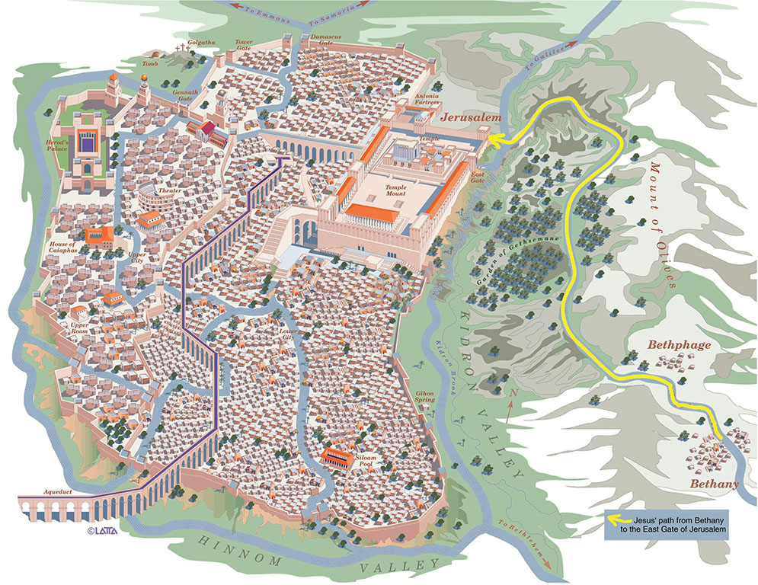
The Lord’s Route on Passover
The Lord’s Route on Passover

Slide 34
Pilate’s Procession
Pilate was the Roman Governor of Judea and entered the city at the head of a squadron of 600 Roman troops.
This procession was marked by all of the insignia and panoply of empire: the standards, the flags, the troops on horses
It was a grand imperial procession entering Jerusalem from the west intended to quell any rebellion.
Pilate did not live in Jerusalem, but in Caesarea on the seacoast, Caesarea Maritima, the location of Roman provincial administration over Judea
Three times a year, Pilate made the trip to Jerusalem at each of the three major Jewish festivals

Slide 35
Jesus’ Procession
On the other side of town was Jesus’ procession.
Yet, as great as His Triumphal Procession was, we should never forget that Jesus had joined the High Priest’s Passover procession as well.
In that procession, He had to allow Himself to be declared Messiah by the crowd
He also had to fulfill the type of the Passover Lamb.

Slide 36
Jesus, Our Passover Lamb
It was fitting that He, Our Passover, would present Himself for examination.
And, in fact, four kinds of authority declared him innocent (pure and unspotted)
The Jewish High Priest and the Sanhedrin couldn’t find any evidence against him. (Mark 14:55)
Judas, speaking for Hell said He betrayed innocent blood. (Matt. 27:4)
Herod, the Jewish secular authority, said that He had done nothing to deserve death. (Luke 23:15)
The Roman government (Pilate) said He had found no basis for the charges against Jesus. (Luke 23:13-16)

Slide 37
Our Passover is King of Kings!
Here we see Jesus challenging the power of Rome and entering Jerusalem, acting as though He had already won the war!
He actually had, but nobody but Jesus and His Father knew that Satan’s kingdom would now be defeated.
God’s anointed King ascended Zion and entered Jerusalem on a Donkey, in Triumph, unstoppable
Despite what God’s enemies had tried to do God said,
^{NIV} Psalm 2:6 "I have installed my King on Zion, my holy hill." 7 I will proclaim the decree of the LORD: He said to me, "You are my Son; today I have become your Father.
That is enthronement language! Jesus is in charge!

Slide 38
Our Passover Lamb is King of Kings!
Today, God is offering us a choice: Our King or His King.
Listen again to the prophecy in Zechariah 9 which Christ is now fulfilling:
^{NIV} Zechariah 9:9 Rejoice greatly, O Daughter of Zion! Shout, Daughter of Jerusalem! See, your king comes to you, righteous and having salvation, gentle and riding on a donkey, on a colt, the foal of a donkey. 10 I will take away the chariots from Ephraim and the war-horses from Jerusalem, and the battle bow will be broken. He will proclaim peace to the nations. His rule will extend from sea to sea and from the River to the ends of the earth.

Slide 39
So What?
So, the question God sets before you on Palm Sunday, “Whom do you want to be your King?”
Jesus is righteous and having salvation.
He enters Jerusalem as God’s anointed King ready to die for you.
He is inviting us to everlasting life in the presence of God.
Somehow, you who never before have wanted to become a Christian can hear the voice of this King, saying “Come unto me, and I will give you rest”.
Why not say “Yes” to Him today?
Well … let’s pray!

Slide 40
The End

